Slide 1
Data Protection and UK GDPR – An introduction for Baptist Churches
Image courtesy of ddpavumba at FreeDigitalPhotos.net
Notes:
The UK General Data Protection Regulations and the Data Protection Act affect all organisations (including our church) which process personal data in some way. Data Protection can seem quite technical but we need to think about this as ‘People Protection’ . But why is this important for us as a church?

Slide 2
What is this all about?
Data Protection legislation covers all “personal data” held by organisations (including our church)
It covers all such data held electronically or in paper-based filing systems
Image courtesy of ddpavumba at FreeDigitalPhotos.net
Notes:
(Read from slide)

Slide 3
What is personal data?
Personal data includes any information about living individuals, and from which those individuals can be identified, either directly or in combination with other information held
Image courtesy of ddpavumba at FreeDigitalPhotos.net
Notes:
Again – just read from the slide.

Slide 4
What is personal data?
Personal data includes both factual information and personal opinions. Some examples include:
Contact details
Staff records
Childrens’ groups records
CCTV
Live-stream video
Chat message expressing a view about someone
Image courtesy of ddpavumba at FreeDigitalPhotos.net
Notes:
Again – just read from the slide.

Slide 5
Why is this important for our church?
We have a responsibility to protect all those people whose personal data we hold
We need to manage personal data lawfully
Notes:
So – why is this important for us as a church?
The most important reason is our responsibility to protect the people whose personal data we hold from misuse of that data – we need to ensure we don’t use the data we have in a way which would cause distress to people or be used in a way that they do not anticipate, such as being shared with third parties. Most of us will not have an issue with the way our church uses our data they have but some people will have concerns and it is important to deal with people’s data fairly and appropriately.
The second reason is that it is the law and organisations that get it wrong could be fined. Individuals who are unhappy with the way their information is processed have the right to complain to the Information Commissioner’s Office (ICO). This could then be investigated and if an organisation is found to be in breach of this legislation then, depending on the severity of the offence, fines could be imposed.

Slide 6
What does this mean for our church?
What sort of personal data do we hold?

Slide 7
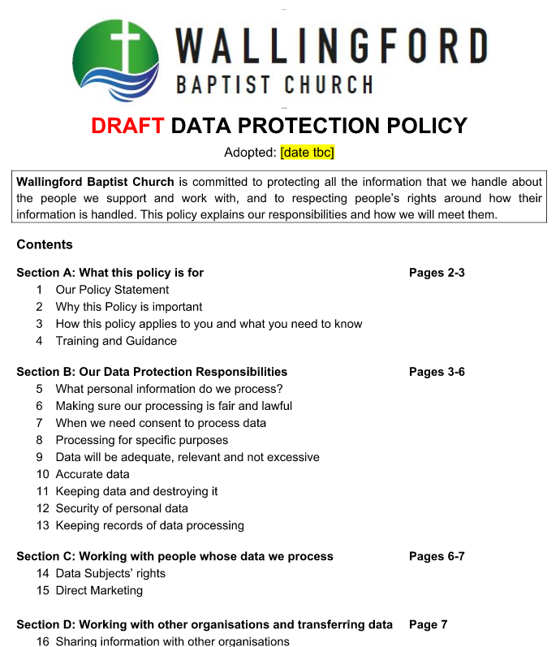
What does this mean for our church?
We have a Data Protection Policy which we will all need to follow

Slide 8
What does this mean for our church?
We have appointed someone to take the lead on Data Protection matters.
Please talk to them if you have any issues or concerns.

Slide 9
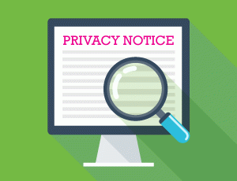
What does this mean for our church?
We need to tell people what information we hold, why we have it and what we will do with it
Notes:
One of the key principles of Data Protection legislation is the importance of people knowing what information we hold about them, why we have it (lawful basis) and what we will do with it. The best way to do this is in something called a ‘Privacy Notice’ or ‘Privacy Statement’.

Slide 10
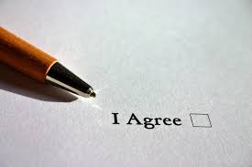
What does this mean for our church?
Sometimes we will need to ask for people’s consent to use their personal data
Notes:
Under data protection law there are various legal grounds which organisations can use to allow them to process personal information. The one which most people are aware of is ‘consent’ but this is not always the most appropriate one. As a church we will generally use something called ‘legitimate interest’ as our lawful basis. It is therefore in the church’s “legitimate interest” to hold the names and contact details of those in membership or regular contact with it. We do not therefore need individuals to give their specific consent for this.
However we will ask people to give their consent for ….

Slide 11
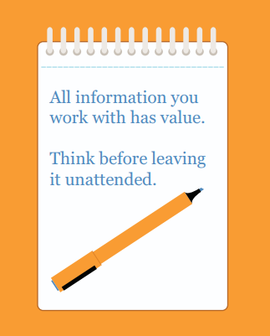
What does this mean for our church?
We will need to make sure we are careful with the personal data we hold as a church and keep our records securely
Notes:
Security of personal data is also important. More care needs to be taken with sensitive data, such as…(give examples)

Slide 12
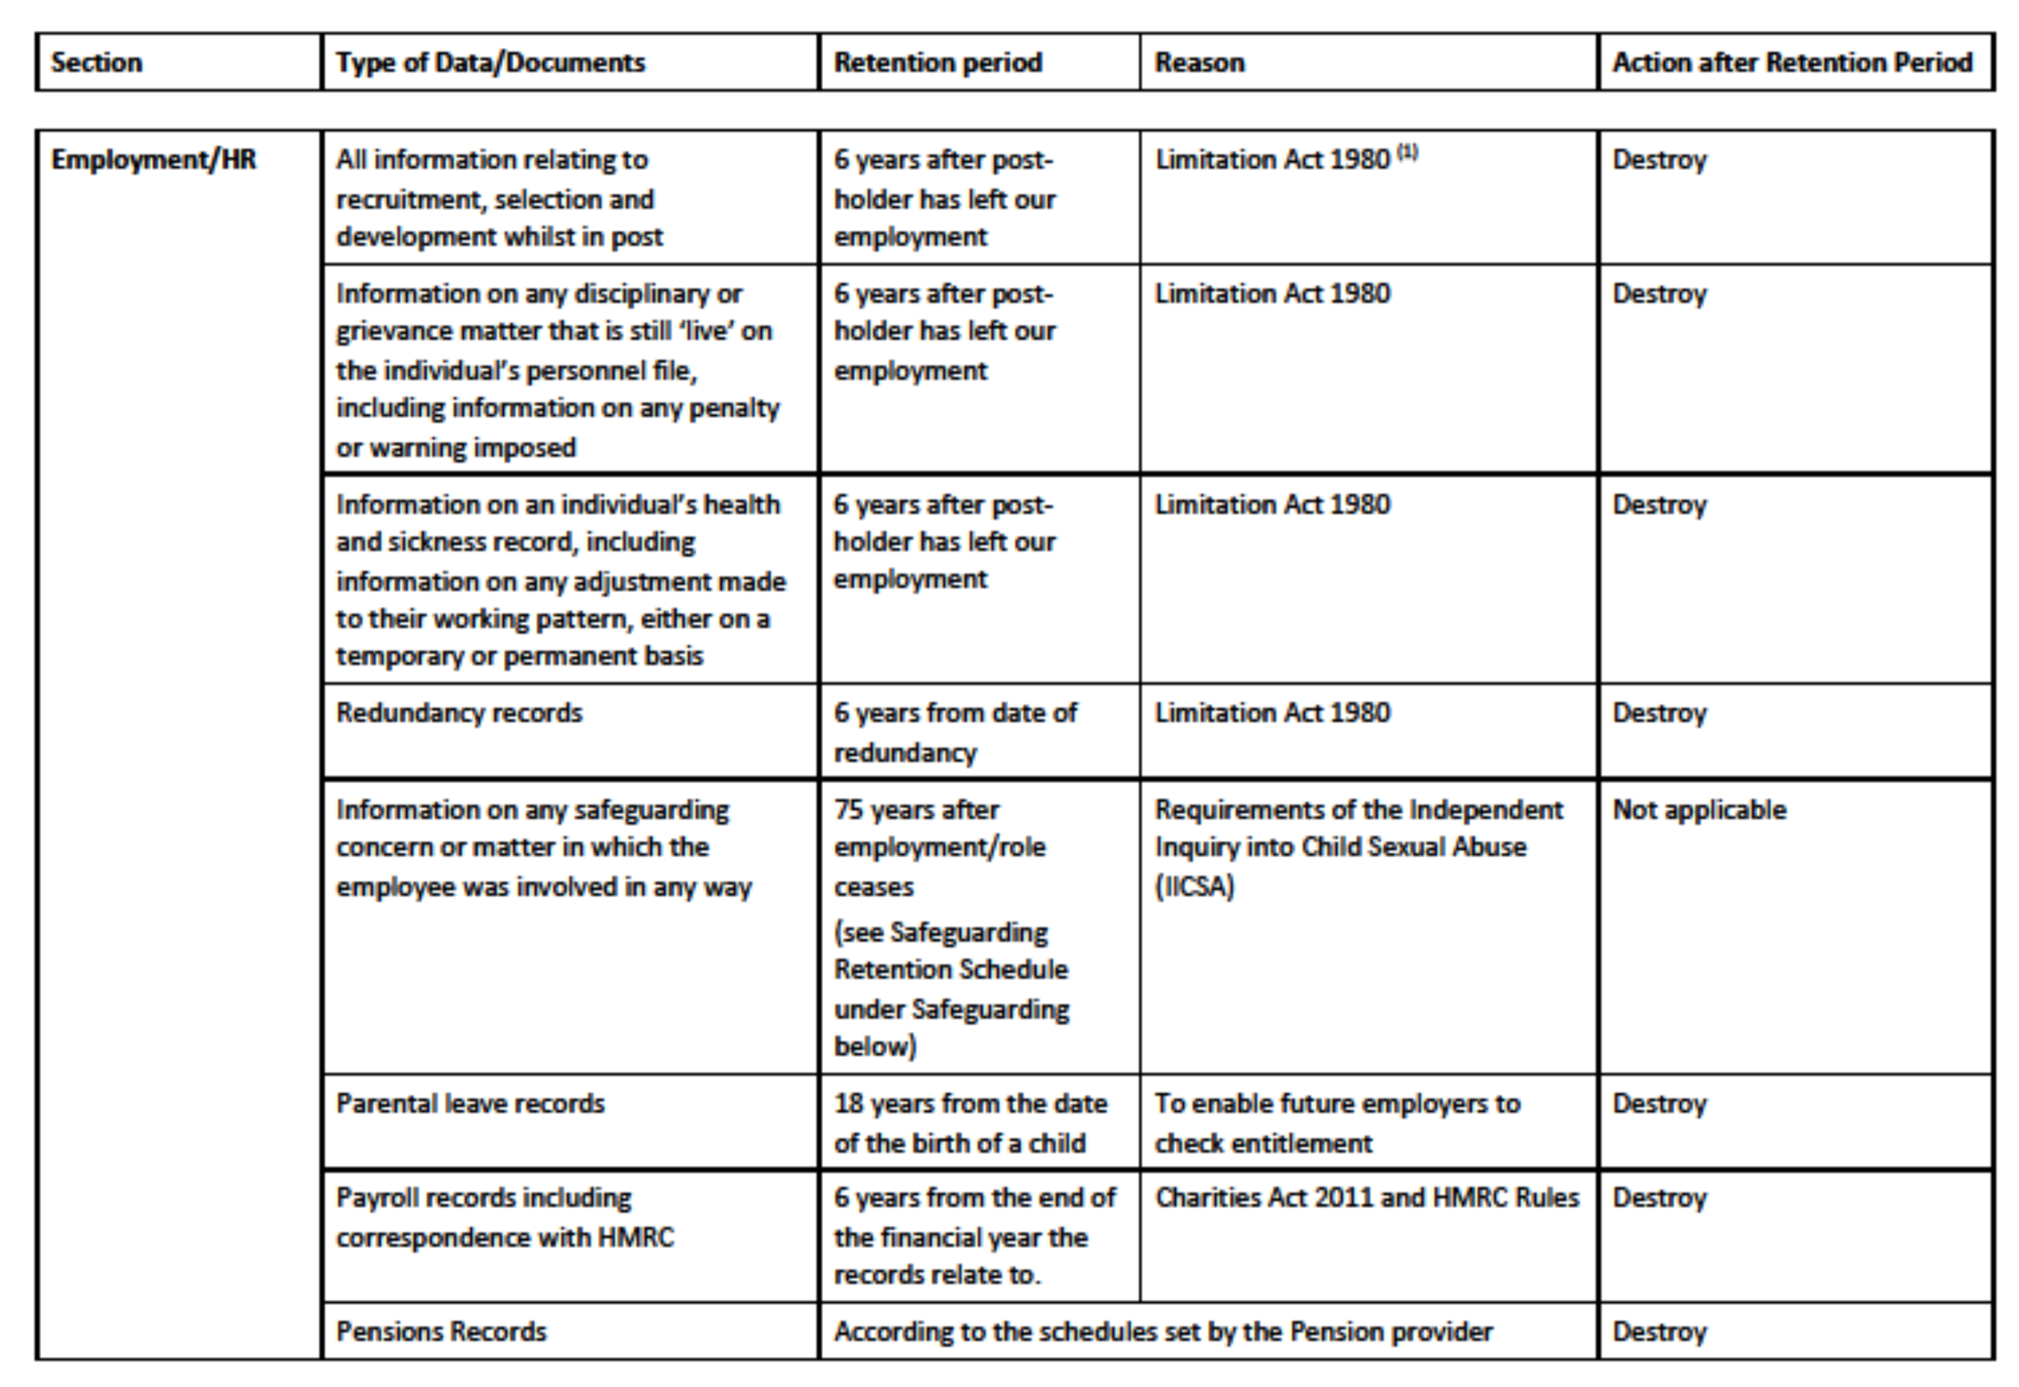
What does this mean for our church?
We must ensure that we do not keep the personal data that we hold for longer than is necessary. Our Data Retention Schedule helps us know how long different types of personal data should be held.
Notes:
Read from the slide. Some records have to be kept permanently or for longer periods of time e.g. safeguarding records have to be kept for 75 years.

Slide 13
Some useful things to remember
Password-protect documents which contain sensitive personal data
Be careful to send emails containing personal data to the right person
Use BCC when sending emails to a group of unconnected people
Be sensitive when using church-related photos within your personal social media
Notes:
There are things all church members need to do to help protect people from misuse of their personal data.

Slide 14
Some useful things to remember
Do not share sensitive personal data (even ‘for prayer’) without consent
If you have church-related personal data on your laptop, tablet or phone make sure the device is pin or password protected
Do not save passwords used to access personal data on any mobile device
Get specific consent when publishing photographs or filming identifiable individuals

Slide 15
BUGB Resources
Dedicated web-page (www.baptist.org.uk/gdpr)
Data Protection webinar recordings for churches:
Information for churches on data protection and GDPR
Subject Access Requests, Data Breaches and Brexit
Guideline leaflet and sample documentation
Notes:
This has only been a fairly brief introduction to the subject of Data Protection and how it affects our church.
The Baptist Union have produced a number of resources to help their member churches and if anyone is interested in these they can be found on the BU website

Slide 16
Data Protection – It’s all about protecting people!
Image courtesy of ddpavumba at FreeDigitalPhotos.net
Notes:
A final reminder why this is important.

