Slide 1
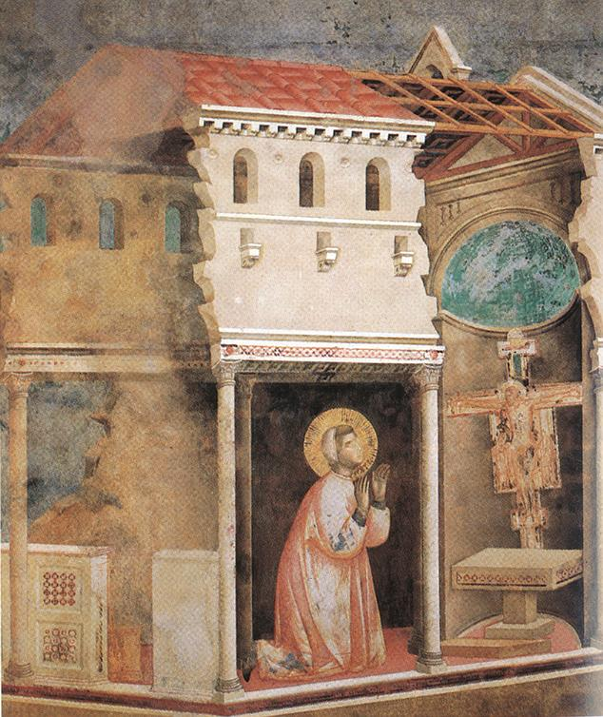
Rebuild My Church!
Simon Goddard

Slide 2
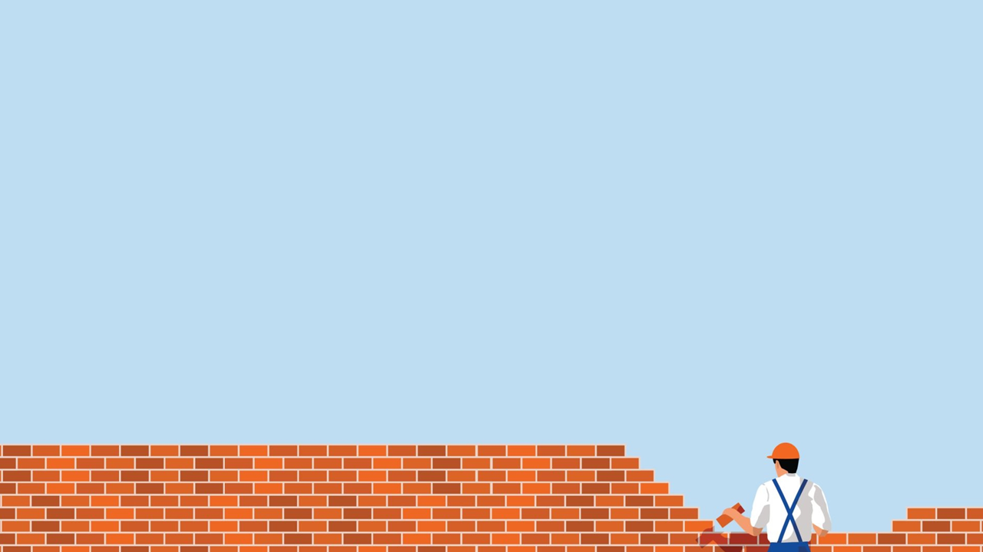
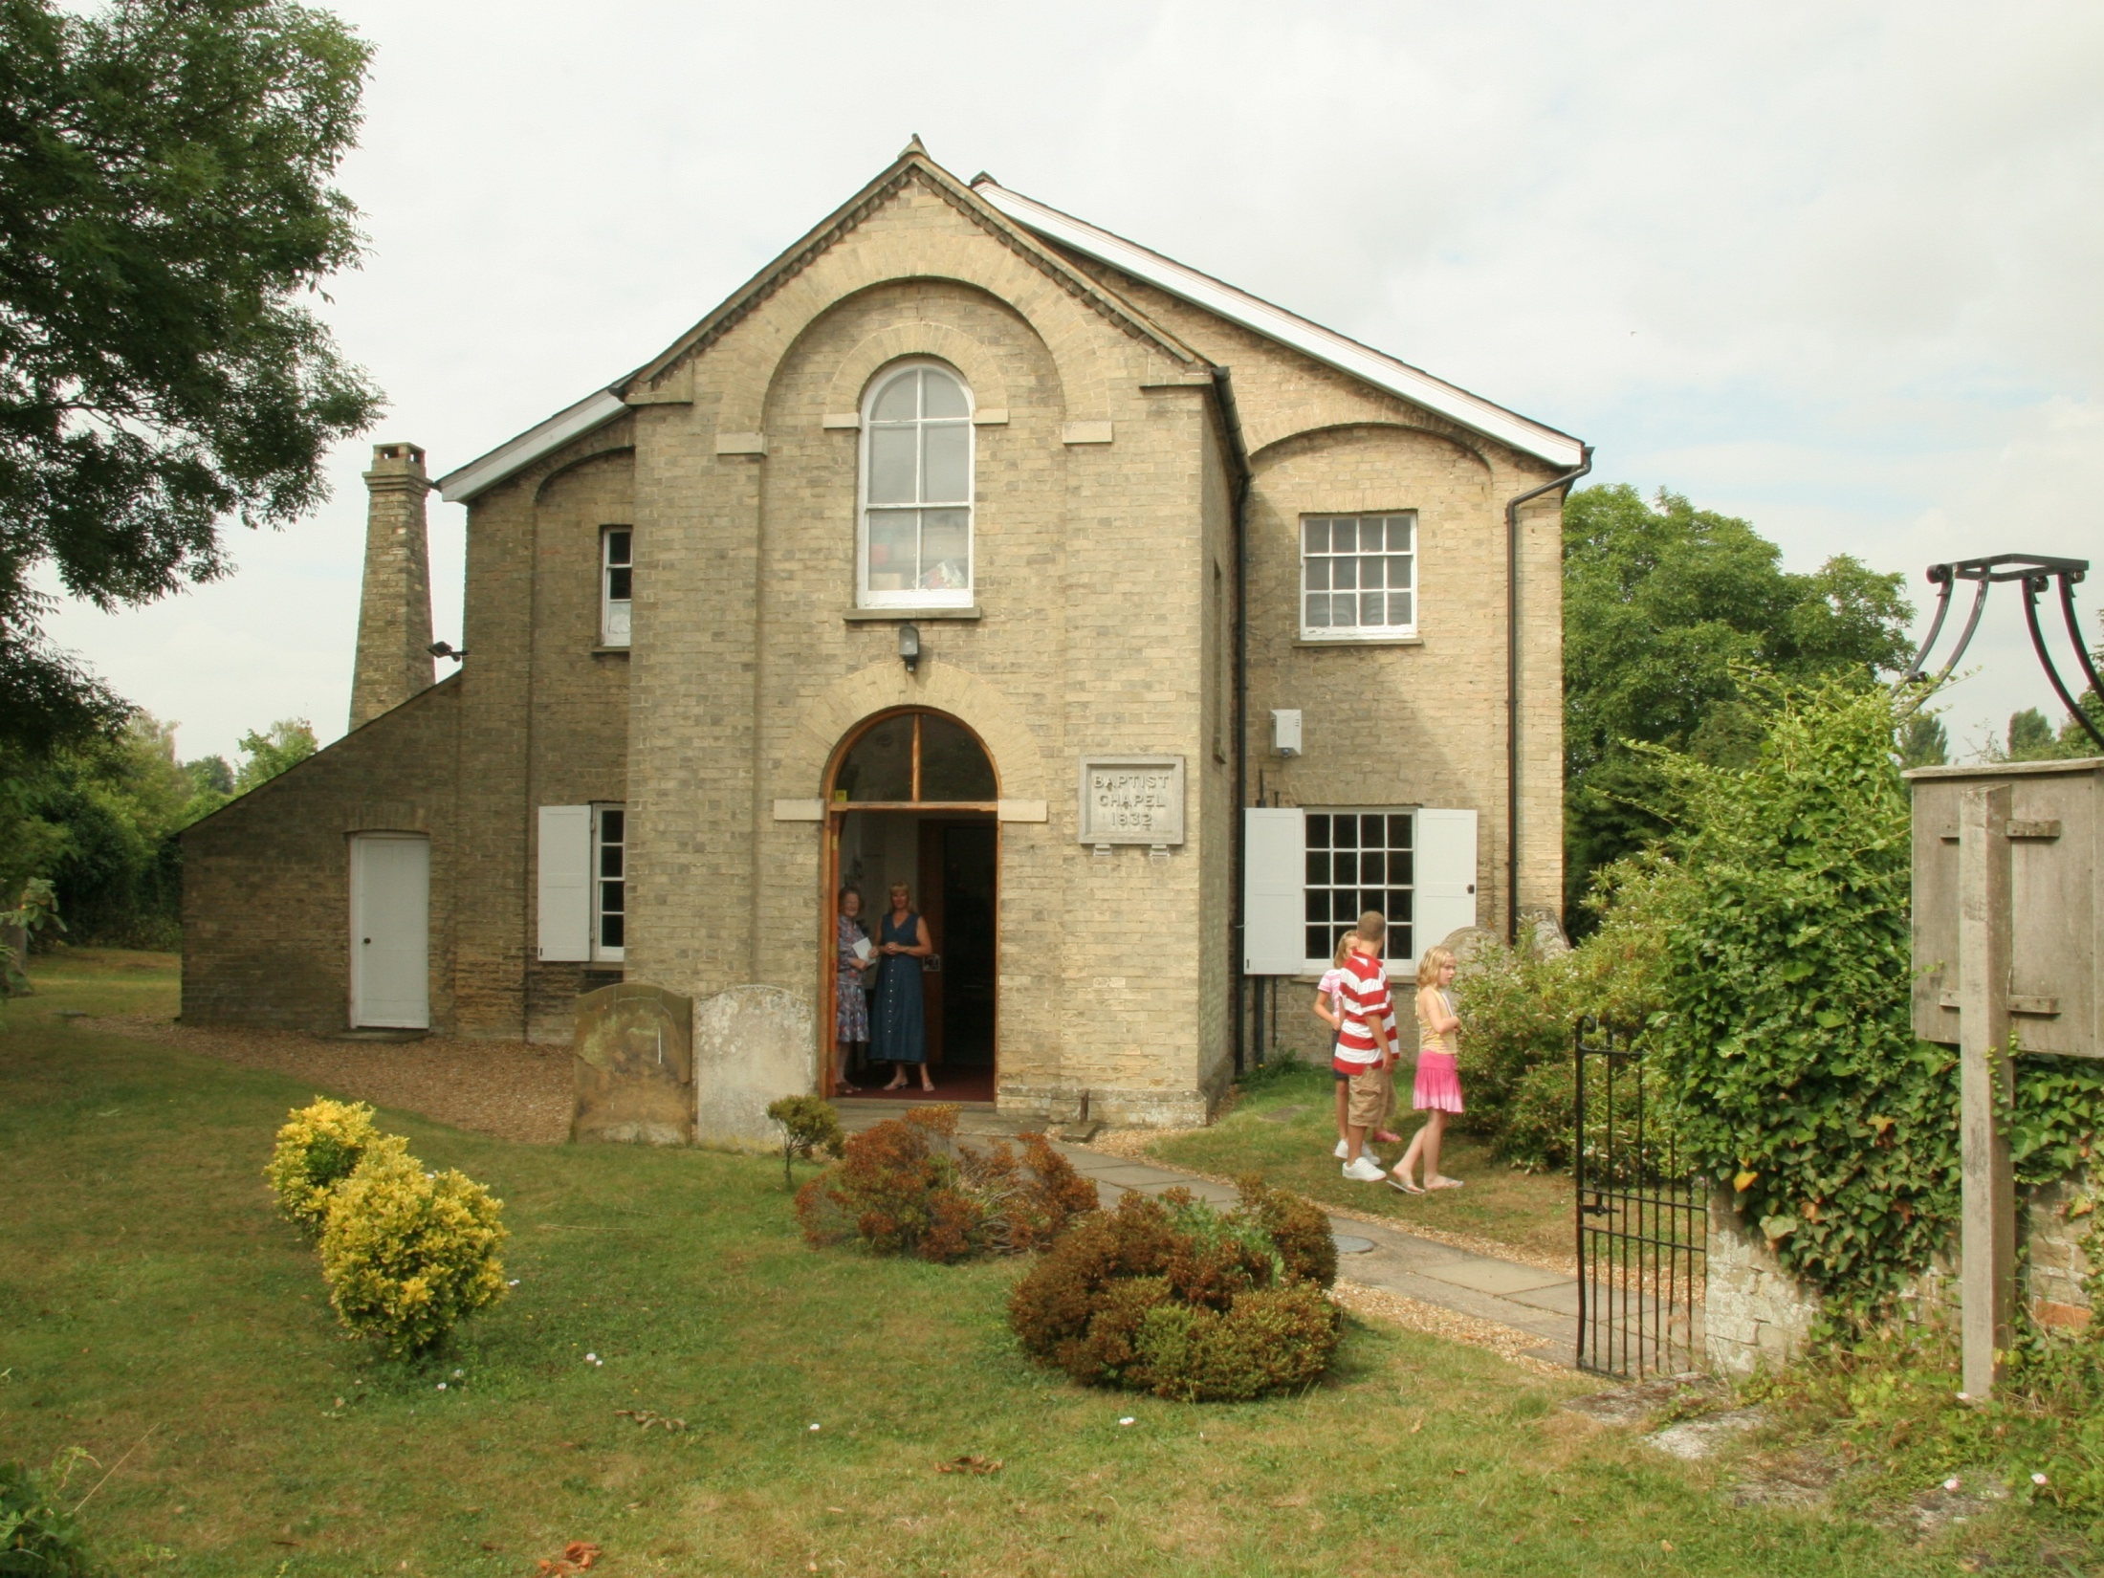
Who am I?

Slide 3
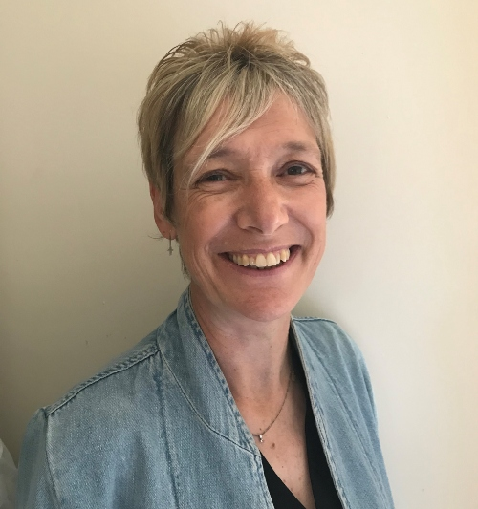
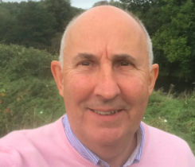
Who am I?

Slide 4
…and breathe!
Don’t rush ‘back to normal’
Don’t be too quick to do ‘new things’ either
Rest, reflect and restore resilience

Slide 5
Take stock…
What’s happened over the last year or so?
For individuals?
For the church corporately?
For your community?
Losses to lament?
Opportunities to consider?

Slide 6
Shut down – or speeded up?
What has accelerated during lockdown?
Further decline (in people/finances)?
Creativity and innovation in mission?
Who has thrived in this season?
Future leaders, equipped for future change?

Slide 7
Rebuild or Reset?
Will rebuilding what was there before be sufficient for what lies ahead?

Slide 8
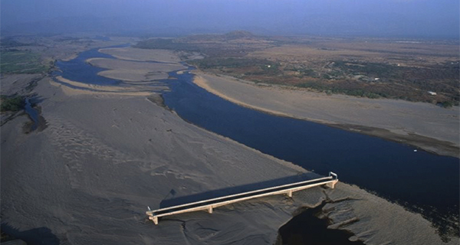

Slide 9
Rebuild or Reset?
Will rebuilding what was there before be sufficient for what lies ahead?
Or is a ‘factory reset’ required?
Are you ready to re-imagine?

Slide 10
Lessons Learned
The rule of six – the power of the small
The importance of being good neighbours
The presence of a spiritual hunger
The new era of online and ‘hybrid’
Change is possible in the church!

Slide 11
Time for a Distributed Church?
What did your church do during lockdown?
Are you talking gathered or scattered?
How do we distribute mission and ministry?
Mindset shift: the church as mission agency and members as missionaries

Slide 12
Time for a Distributed Church?
Not how many are coming, but how many have we equipped to go?
Jesus said: “I will build the church”
We are told: “Go and make disciples”
“To equip the saints…” (Ephesians 4:11-13)

Slide 13
Time for a Distributed Church?
Not how many are coming, but how many have we equipped to go?
Jesus said: “I will build the church”
We are told: “Go and make disciples”
“To equip the saints…” (Ephesians 4:11-13)

Slide 14
Biblical Discipleship

Slide 15
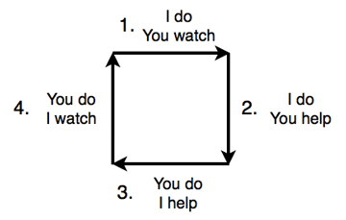
Preparing for Ascension

Slide 16
Distributed Church
http://bit.ly/distributedchurchrecordings
21st Century Christian
www.fxresourcing.org/shop

Slide 17
Breakout Groups
What do you think about the ‘distributed church’ idea, and the other things I said?

Slide 18
Questions?

Slide 19
Three Tools To Consider
Start with Why
Taking a S.H.A.P.E. Inventory
The Season Assessment

Slide 20
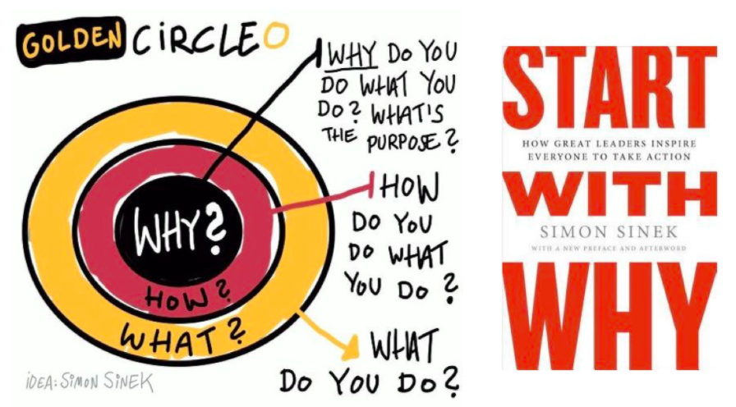

Slide 21
Start with Why
Clarify your Vision – why do you exist?
Clarify your Values – what do you value as you pursue your purpose?
Then work out the Activities that move you towards your vision in line with your values

Slide 22
Taking a S.H.A.P.E. Inventory
S.piritual Gifts
H.eart
A.bilities
P.assion
E.xperience

Slide 23
The Season Assessment
For each activity that might be restarting:
Consider which season it was in…
Spring – there were signs of future fruitfulness
Summer – it was flourishing and fruitful
Autumn – time to give thanks and end well
Winter – time to reflect and recycle resources

Slide 24
Breakout Groups
What could you do?
What will you do?

Slide 25
Feel free to contact me:
Simon Goddard
simon@rivertree.org.uk
07930 148094

Slide 26
Prayer

