Slide 1
Introduction to Pensions for Baptist Churches
Friday 20 September 2020
Steve Kaney, Pension Manager, Baptist Pension Scheme
Richard Wilson Support Services Team Leader

Slide 2
Outline
Introduction – Pensions Challenges?
Your legal obligations and Auto Enrolment
Overview of the Baptist Pension Scheme
The Defined Contribution Scheme
The Defined Benefit Scheme (Closed)
Questions
NB – this webinar is intended for Employers and is not focussed on scheme members.
Notes:
RW slide

Slide 3
Introduction – Pensions Challenges
As Baptist churches we want to be model employers:
Ensure that ministers and staff in Baptist organisations are provided for in retirement.
Comply with the legal obligations on in respect to Pensions
Notes:
RW slide

Slide 4
Your Legal Obligations
Auto enrolment:
Assess staff for eligibility based on age and salary
Select a Qualifying Workplace Scheme, such as BPS
Enrol eligible staff
Re-enrol staff who opt out every 3 years
Minimum contribution levels (at least 8% of earnings, with at least 3% paid by employer)
More detail at https://tpr.gov.uk/employers
Notes:
RW slide

Slide 5
Overview of the Baptist Pension Scheme
Scheme structure:
Defined Contribution Scheme
Basic Section
Ministers Section
Staff Section
Defined Benefit Scheme
Closed scheme
Notes:
SK slide

Slide 6
Overview of the Baptist Pension Scheme
Who’s who in the scheme? [1]
Trustees – BPTL, independent from BUGB
Pensions Staff: Steve Kaney, Marshall Rowan & Helen Lukies
BBS – scheme administrators
LCP – actuaries and investment advisors
Eversheds – legal advisers
Notes:
SK slide

Slide 7
Overview of the Baptist Pension Scheme
Who’s who in the scheme? [2]
tPR – The Pensions Regulator
BUGB – lead employer in the rules
Employers – c. 1,100 individual organisations
Employers’ Group
Notes:
SK slide

Slide 8
Overview of the Baptist Pension Scheme
The Employer Hub: www.4mystaff.co.uk
Provided by BBS, scheme administrators
Allows employers to:
Update employer contact info
Update employee/member information
Submit accounts information
See employer debt information (DB section)
Notes:
SK slide

Slide 9
The BPS Defined Contribution Section
What is a “Defined Contribution” pension scheme?
Employer and employee make contributions
Money is invested in:
Default investments, or
member selected investments
Member uses funds to fund retirement
Investment Risk/Reward is with member
Notes:
SK slide

Slide 10
The BPS Defined Contribution Section
Standard Contribution rates (% of pensionable income)
 | Basic | Ministers | Staff
Employee Contributions | 5% | 8% | 8%
Employer Contributions | 4% | 6% | 6%
Insurances and Expenses Charges (paid by employers) | 1% | 3%/4%* | 3%/4%*
* Employers who are members of the Defined Benefit section pay a higher expense allowance
Notes:
SK slide

Slide 11
The BPS Defined Contribution Section
Insurance included within ministers & staff sections
Income Protection
Pays 50% of pensionable income after 26 weeks off sick, up to retirement date
Life insurance, the greater of
8 x Pensionable Income and
4 x Pensionable Income, plus the value of your Pension Account
Notes:
SK slide

Slide 12
The BPS Defined Contribution Section
Investment options (member choice):
Default Lifestyle Investment
Reduces risk level as member approaches nominated retirement date
Set by the Trustee on advice of LCP
Self-select fund options
Member chooses how contributions are invested between a range of funds
Notes:
SK slide

Slide 13
The BPS Master Trust
Authorised as a Master Trust Sept 2019
Non-Associated Multi-Employer Schemes
Higher level of regulation
Pension Trustee & BUGB Trustees
Scheme Strategists
Most Master Trusts are commercial
We don’t fit the mould!
Notes:
SK slide

Slide 14
The BPS Defined Contribution Section
Your obligations as an employer:
Promptly provide employee and salary details to BPS (via Employer Hub)
Pay contributions (taken via Direct Debit)
Meet Auto Enrolment obligations
Notes:
SK slide

Slide 15
The BPS Defined Benefit Section
What is a “Defined Benefit” (DB) pension scheme?
Employer and employee make contributions
Scheme commits to providing specified benefits in retirement
Money is invested by the scheme to fund benefits
Investment Risk/Reward is with employers
Employers must make additional contributions if scheme cannot pay the promised benefits
Notes:
RW slide

Slide 16
The BPS Defined Benefit Section
About the BPS DB section
Scheme closed at end 2011
No new members or employers since then
No accrual of additional years of service
Benefits still tied to current pensionable income
Multi-employer scheme with around 1,100 employers (mostly churches)
Notes:
RW slide

Slide 17
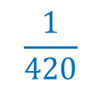
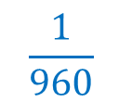
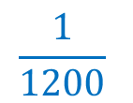
The BPS Defined Benefit Section
The benefits offered were:
Std annuity at retirement / leaving
Complete months of Pensionable service before 1 Jan 1985
$$\frac{1}{420}$$
X
X
Complete months of Pensionable service 1 Jan 1985 to 31 Dec 1990
$$\frac{1}{1200}$$
Final Minimum Pensionable Income
X
X
Complete months of Pensionable service 1 Jan 1991 to 31 Dec 2011
$$\frac{1}{960}$$
Final Minimum Pensionable Income
X
X
Notes:
RW slide

Slide 18
The BPS Defined Benefit Section
The employers are legally obliged to fund these benefits
This has turned out to be much more expensive than originally anticipated due to
Higher life expectancies, so pensions must be paid for longer.
Lower interest rates meaning that more money is needed now to fund a future obligation
Notes:
RW slide

Slide 19
The BPS Defined Benefit Section
The scheme currently has around £300m assets
These are held in a range of investments
The investment portfolio is designed to
Produce a good return…
…whilst keeping risk down…
…and matching the cost of the benefits.
Notes:
RW slide

Slide 20
The BPS Defined Benefit Section
Every three years all Defined Benefits pension schemes must carry out a formal valuation:
Calculate the amount of money needed now to cover the projected cost of the benefits
Compare to the scheme assets
Agree a “recovery plan” with employers to address any shortfall
Notes:
RW slide

Slide 21
The BPS Defined Benefit Section
Last valuation was as at 31st December 2016
Deficit of £93m
A recovery plan, “The Family Solution” was agreed in April 2018
BUGB to contribute an additional £33.5m
All employers continue their deficit recovery contributions until end 2028.
Some changes made to the inflation- adjustment of benefits
Notes:
RW slide

Slide 22
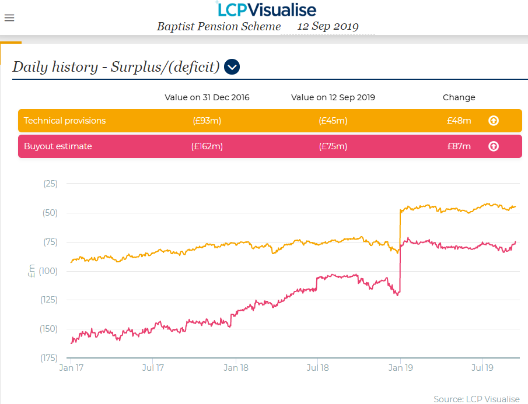
The BPS Defined Benefit Section
The Family Solution Recovery plan is currently on track, but…
Deficit moves daily with financial markets
The risk remains with the employers
Notes:
RW slide

Slide 23
Actuarial Terminology & Risks
‘Technical Provisions’
the cost of paying the benefits with no extra Employer cost, provided assumptions are borne out. - i.e. risk is maintained
‘Buy Out’ (“solvency basis”)
the cost of securing befits with an Insurance Company – i.e. risk removed
Notes:
RW slide

Slide 24
The BPS Defined Benefit Section
Next valuation will be as at 31st December 2019
Work will be carried on in 2020
Regulator deadline for completion is March 2021, but aiming to complete sooner
BUGB’s aim will be to maintain the current recovery plan as far as that is possible
The Pension Trustee’s aim will be to ensure continued security for members’ benefits
Collaborative approach
Notes:
RW slide

Slide 25
The BPS Defined Benefit Section
BUGB’s long term objective is to pay one or more insurers to take on responsibility for paying the benefits
A process known as “buy-out”
Feasible target in a 10-year horizon
BUGB currently working with the Trustee on a “buy-in”
Purchase a bulk annuity policy to match around a third of the liabilities
A step towards buy-out
Notes:
RW slide

Slide 26
The BPS Defined Benefit Section
Pension Act 2005: Made it much harder for employers to avoid their pension liabilities
Departing employers (i.e. those with no active employees) in multi-employer schemes must settle their share of scheme liability immediately.
This is known as a “Cessation Event”
Patterns of ministry mean many BPS employers have had Cessation Events
Notes:
SK slide

Slide 27
The BPS Defined Benefit Section
In a Cessation Event the employer must pay their “Employer Debt”
Share of deficit based on cost of paying an insurer to take on scheme liabilities
Monthly estimate provided for most employers on www.4mystaff.co.uk
Ranges from a few thousand pounds to several hundred thousand depending upon the employer history in the scheme
Notes:
SK slide

Slide 28
The BPS Defined Benefit Section
How to ‘avoid’ a Cessation Event:
Period of Grace (1 year, extendable to 3 years)
Interim Member
Deferred Debt Agreement (DDA) (historic cases)
Follow the correct process to convert to a CIO
BBS can advise on process to follow.
Please ensure you update them promptly on leavers
Notes:
SK slide

Slide 29
The BPS Defined Benefit Section
If you are an active employer you have a choice:
Option 1: Continue to participate in the scheme
Pay deficit contributions
These may be revised in future if the scheme performs worse (or better) than forecast
As a continuing employer, you share in risk of the scheme
Notes:
RW slide

Slide 30
The BPS Defined Benefit Section
If you are an active employer you have a choice:
Option 2: Settle your employer debt
Pay the one off amount to exit the scheme
No further obligations to the DB scheme and do not share in the future risks of the scheme
Can continue to participate in DC scheme as a DC-only employer
Notes:
RW slide

Slide 31
The BPS Defined Benefit Section
Best choice for your church will depend on
The deficit contributions you are paying
The estimated debt you would have to pay (available on www.4mystaff.co.uk)
Your ability to pay the find the funds to pay the debt
Your church’s attitude to risk
You may need independent financial advice to support a decision
Notes:
RW slide

Slide 32
The BPS Defined Benefit Section
Double Cessation Events:
360 employers have had at least one cessation event and then re-entered the scheme
The Employer Debt regulations have a flaw that means in these circumstances some parts of the liability are payable twice
This has been a long-standing issue for the scheme and the affected churches
Notes:
SK slide

Slide 33
The BPS Defined Benefit Section
As part of the Family Solution, a mechanism has been found to address Double Cessation Events
BUGB’s contribution will be used to nominally settle the earlier cessation debts
This leaves the church with only their current liability, which is a fair reflection of their share of scheme liabilities
Notes:
SK slide

Slide 34
The BPS Defined Benefit Section
To participate in the solution Churches need to sign a Double Cessation Debt Agreement (DCDA) agreeing to this.
If the church don’t agree, the church will need to settle their cessation debt.
Notes:
SK slide

Slide 35
The BPS Defined Benefit Section
In summary, your obligations as a DB employer:
Pay deficit contributions
Provide annual accounts to the Trustee
Read communications from the scheme
Avoid (unintended) cessation events
Notes:
SK slide

Slide 36
Any questions?

